Slide 1
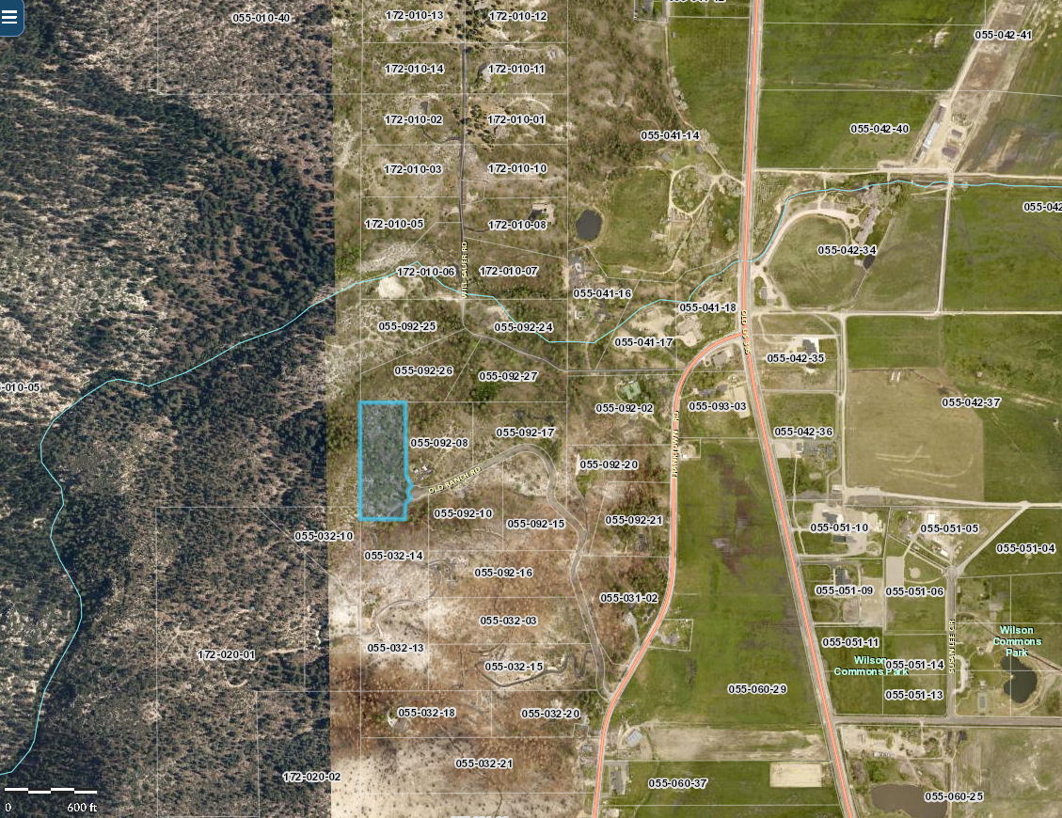
WSUP20-0004
Smith Residence Grading
Washoe County Board of Adjustment
May 7, 2020

Slide 2
Background/Request
The applicant is requesting approve a major grading permit for:
  2,940 cubic yards of cut and 1,790 cubic yards of fill across 33,200 square feet of area on slopes exceeding 15%
  the construction of a permanent earthen structure over 4½ feet in height within the front yard setback and over 6 feet in height outside of the front yard setback.

Slide 3
Vicinity Map

Slide 4
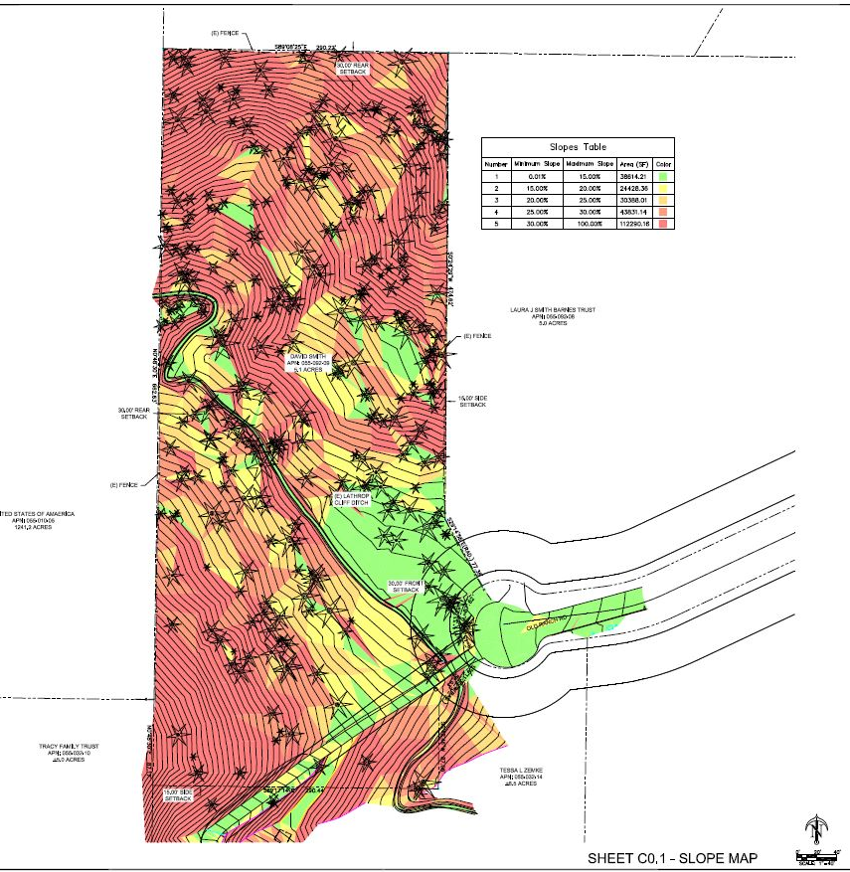
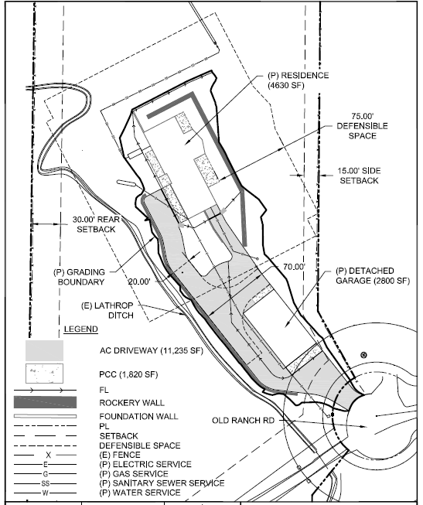
Site Plan/ Slope Map

Slide 5
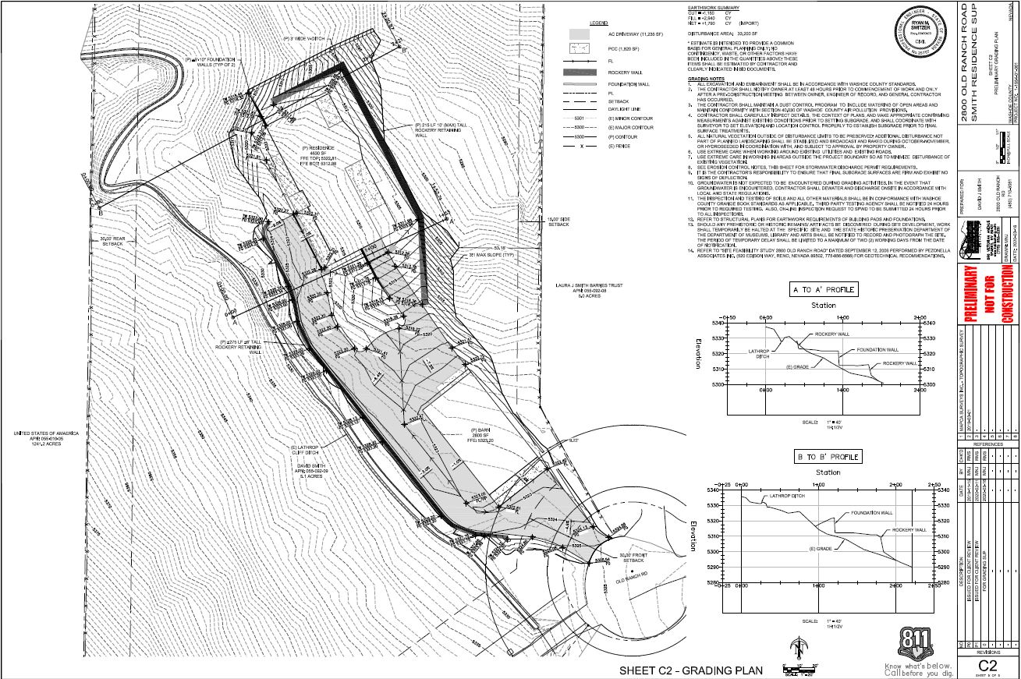
Grading Plan

Slide 6
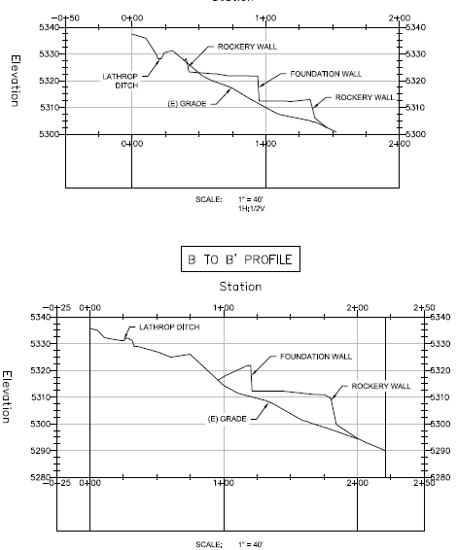
Grading Profiles

Slide 7
Analysis
Proposed grading conforms with the requirements in the WWC 110.438.45 as summarized below.
Type of Regulation | Requirements
 | Front Yard | Side Yard | Rear Yard | Setback Envelope
Slopes | 3:1 | 3:1 | 3:1 | 3:1
Difference from Natural Grade | 4ft | 4ft | 4ft | 10ft
Retaining Wall Height | 4.5ft | 6ft Res/8ft non res | 6ft Res/8ft non res | 10ft
Retaining Wall Terrace Widths | Min. 6ft | Min. 6ft | Min. 6ft | Min. 6ft
Retaining Wall Bench Widths | Min. 4ft | Min. 4ft | Min. 4ft | Min. 4ft
Intersection Angle | 45 degrees | 45 degrees | 45 degrees | 45 degrees
Transitions | Contoured | Contoured | Contoured | Contoured

Slide 8
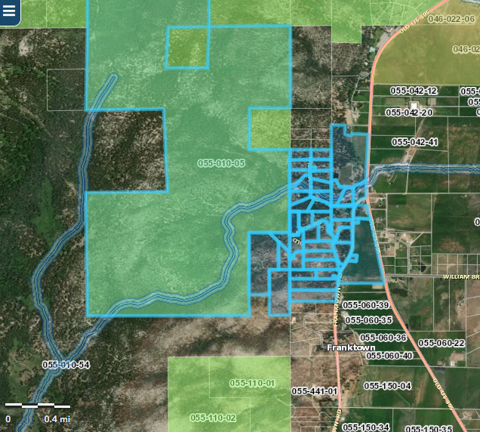
Public Notice & CAB
Notice was sent to 36 affected property owners, 1800 feet from the site.

Slide 9
Citizen Advisory Board
The proposed project was sent to the CAB members for comment due to the “Stay at Home” directive from the Governor in response to COVID-19.
Staff sent out a CAB worksheet to the CAB members to provide comments.
The CAB did not provide any comments on the application.
No public comment received

Slide 10
Special Use Permit Findings
Consistency. That the proposed use is consistent with the action programs, policies, standards and maps of the Master Plan and the North Valleys;
Improvements. That adequate utilities, roadway improvements, sanitation, water supply, drainage, and other necessary facilities have been provided, the proposed improvements are properly related to existing and proposed roadways, and an adequate public facilities determination has been made in accordance with Division Seven;
Site Suitability. That the site is physically suitable for child daycare, and for the intensity of such a development;
Issuance Not Detrimental. That issuance of the permit will not be significantly detrimental to the public health, safety or welfare; injurious to the property or improvements of adjacent properties; or detrimental to the character of the surrounding area;
Effect on a Military Installation. Issuance of the permit will not have a detrimental effect on the location, purpose or mission of the military installation.

Slide 11
Recommendation
Those agencies which reviewed the application recommended conditions to address applicable codes and impacts associated with the project. After a thorough analysis and review, staff recommends that the Board of Adjustment carefully consider all aspects of Special Use Permit Case Number WSUP20-0004 and the nature of the stringent recommended conditions of approval and approve the requested Special Use Permit.

Slide 12
Possible Motion
APPROVAL: I move that, after giving reasoned consideration to the information contained in the staff report and information received during the public hearing, the Washoe County Board of Adjustment approve with conditions Special Use Permit Case Number WSUP20-0004 for David Smith, having made all five findings in accordance with Washoe County Code Section 110.810.30:

